Slide 1
Study for CAR# 143914179

Slide 2
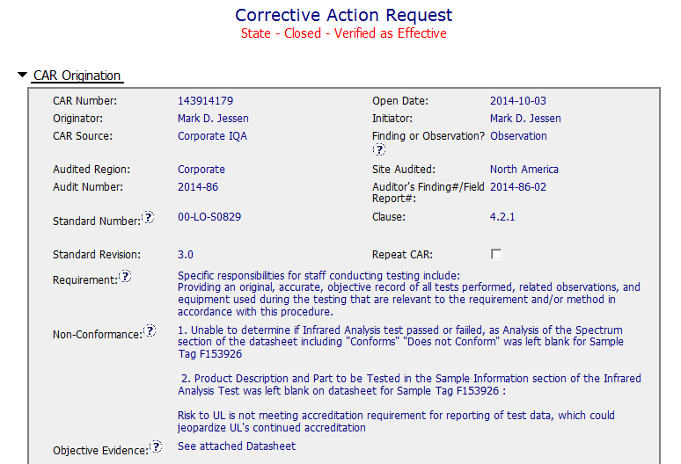
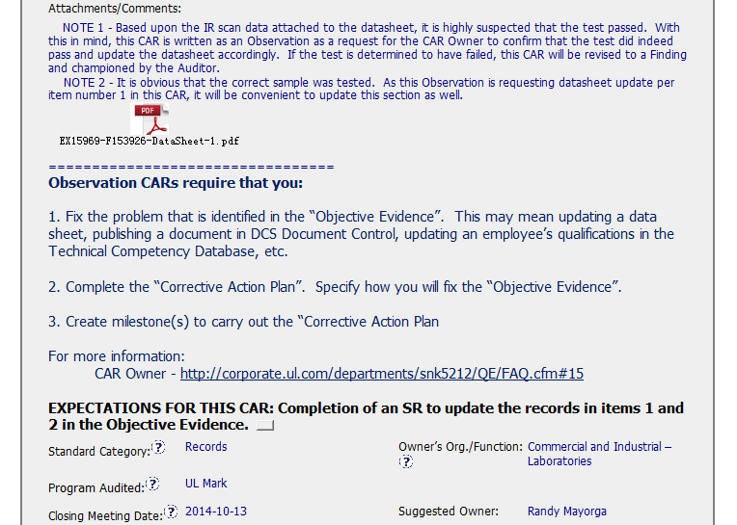
CAR 143914179 – Observation
Guide CAR owner to handle the observation CAR in a correct way
This should be part of the corrective action plan

Slide 3
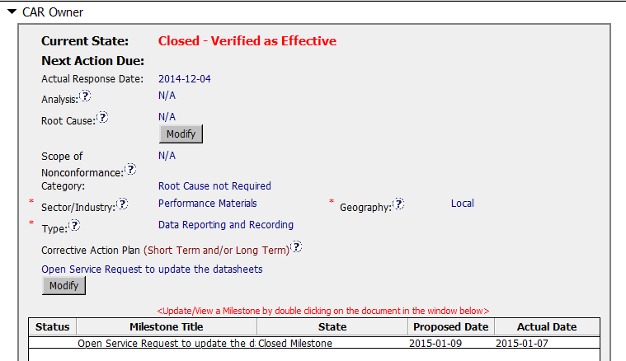
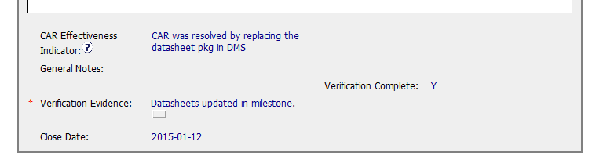
CAR 143914179 – Observation
Category is correct
The action plan should have been more specific how to fix the “Objective Evidence”.

Slide 4
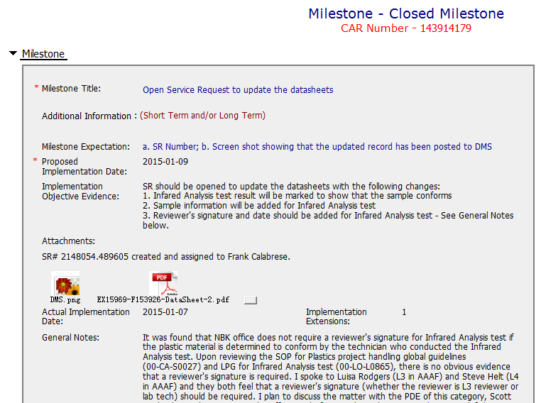
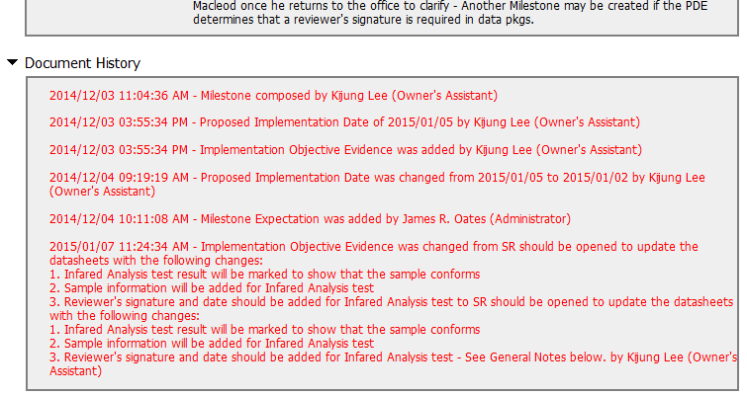
CAR 143914179 – Milestone
Is there any determination whether the Reviewer's signature and date will be added for IA test or not?
It should be clarified before close this CAR
Quote from FAQ #21 Every element of the corrective action plan and all milestones must have corresponding evidence of effective implementation. For example, if the corrective action plan included the creation of an audit review, then at least one of these reviews must have taken place before closing the CAR or milestone.

Slide 5
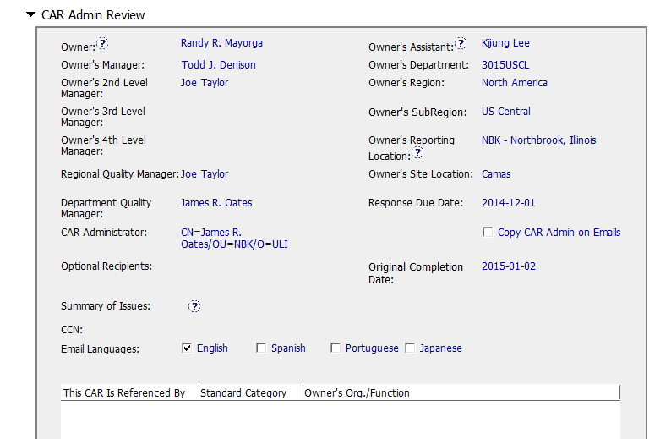
CAR 143914179 – Observation
Correct choice
CAR progress won’t be updated to CAR admin on emails without ticking here (not required)

Slide 6
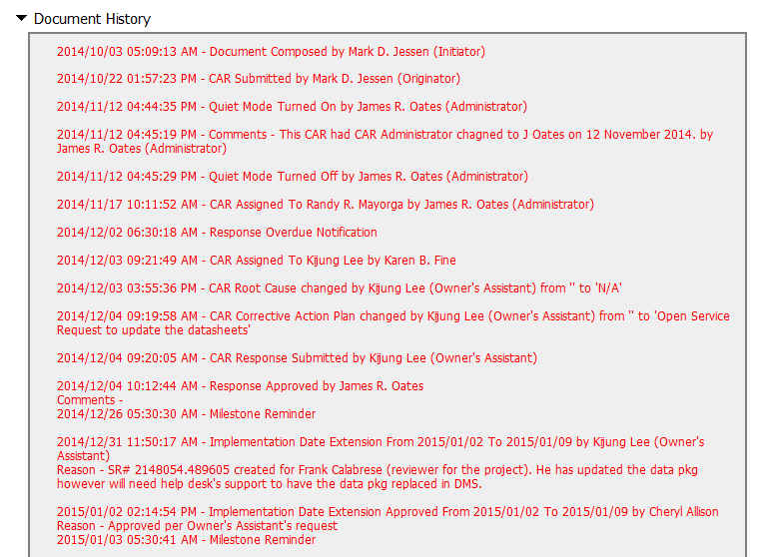
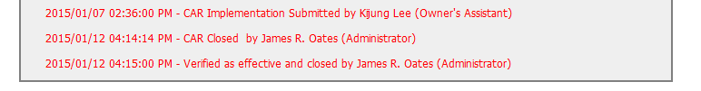
CAR 143914179 – CAR History
Long waiting time before get response after the CAR issued
Per FQA #10
Add a comment to the CAR indicating that CAR Champion contacted the owner
- Include helpful details related to the contact
- Comments provide details that are helpful should the CAR go into manual escalation
The extension is necessary to accomplish the milestone expectation and extension request is reasonable with pertinent information provided by the CAR owner.

Slide 7
CAR 143914179 – CBS Check
CBS Requirements | Excellent | Moderate | Need Improve | N/A
(C) Extensions are within requirement (<30 days, 3 or less) | X
(T) Most appropriate ‘category’, ‘type’, ‘geography’ are selected | X
(P) Facilitates the handling of disputed CARs |  |  |  | X
(T) Acts on CARs within required timeframe | X
(C) Analysis shows clear path to root cause and scope; stakeholders identified |  |  |  | X
(C) Root cause statement is succinct, reasonable, complete (Shows ‘N/A’ for observations) |  |  |  | X
(C) Corrective actions fix the objective evidence and other problems found; address entire root cause and scope. For observations, they do not go beyond fixing the objective evidence | X
(C) Milestones address containment & owner’s verification; completed per milestone expectations |  |  | X
(P) Verification per requirements |  |  | X
(L) Referenced communications are attached as needed | X
(C L) Evidence of communication for overdue/escalated CARs and other pertinent concerns |  |  | X
(P) Trains other CAR Champions |  |  |  | X

